Slide 1

BLENDED PRODUCTS:
Satellite based precipitation estimation
Estelle de Coning
Chief Scientist: Nowcasting and very short range forecasting

Slide 2
How can we measure precipitation?
Rain gauges:
  provide a direct measurement of rainfall,
  networks are far too coarse to capture all the rainfall, especially at smaller scales
  unevenly distributed and,
  most importantly, they provide point source data and not a representation of a spatial domain
Radars rainfall:
  an indirect measurement of rainfall,
  radars need to cover the entire area of interest,
  Well correlated and
  have a good radar rainfall relationship.
Satellite based estimates of rainfall:
  not as accurate as gauges or radar,
  major advantage is the high temporal resolution and coverage, even over oceans, in mountainous regions and sparsely populated areas where rainfall is not measured.

Slide 3
Fourth meeting of the CBS-SWFDP Steering Group in Geneva, February 2012:
  Challenge for the SWFDP: “the need for very short-range forecasting tools, to address especially the rapid onset of localized severe thunderstorms which can produce heavy precipitation and strong wind, given the absence of adequate real-time observational networks, especially weather radar coverage.”
  The usefulness of EUMETSAT satellite based instability products, such as the Global Instability Index, for nowcasting purposes was recognized
  Also agreed that real time satellite rainfall estimates have proven particularly useful in regions where rain gauges and radar coverage is sparse.
Surface-based precipitation measurement systems in DC and LDC still needed to accurately measure and monitor precipitation amounts on the ground, to be incorporated into hydrological runoff models as well as aid in validation of other (satellite and model based) methodologies.

Slide 4
Sources of satellite QPE
Satellite rainfall can be derived from low earth orbiting (LEO) or geostationary satellites (GEO).
LEO satellites:
  advantage of high spatial resolution,
  disadvantage is that the spatial coverage is in the form of narrow swaths at times which are not always coinciding with precipitating weather systems.
  not useful for operational forecasting purposes, although the data can be utilized for other purposes, including data assimilation for numerical weather prediction (NWP).
  the main advantage of LEO satellites is that the microwave sensors carried by these low orbiting satellites have a more direct link to precipitation than the instruments on board GEO satellites.

Slide 5
  GEO satellites:
    are located much higher above the earth surface than the LEO satellites and thus have a coarser resolution.
    major advantage that the data and images are available in near real-time for the entire footprint of the satellite.
    operational forecasting requires frequent updates and near real-time availability. Forecasters who have to monitor and forecast the movement and changes in intensity of precipitating weather features, find GEO most useful

Slide 6
The Hydroestimator - Cold Cloud Tops and Rain Principle
T_{b}=200 K
T_{b}=212 K
T_{b}=224 K
T_{b}=230 K
200
250
290K

Slide 7
Hydroestimator – a blended product
Satellite imagery alone does not contain all the information needed for evaluating rainfall. Numerous processes occur below clouds e.g.:
  evaporation of raindrops in dry air,
  reduction or increase by terrain features
Improvements to the HE considers some correction figures taken from numerical weather prediction models:
  PW: rain is enhanced/reduced in high/low PW
  RH: reduces rain in dry lower atmosphere
  Actual level of neutral buoyancy is accounted for
  700 hPa wind field is interleaved with the topography

Slide 8
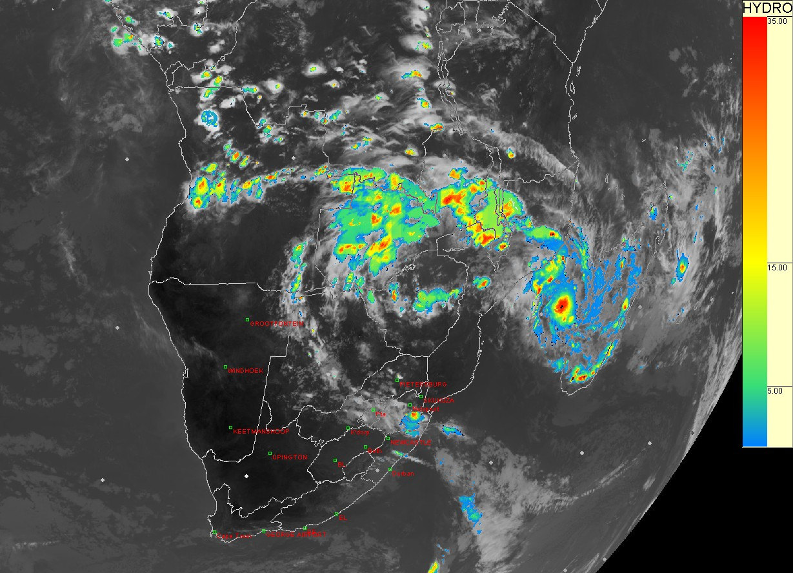
Hydroestimator for southern Africa (UM) – operationally available every 15 minutes

Slide 9
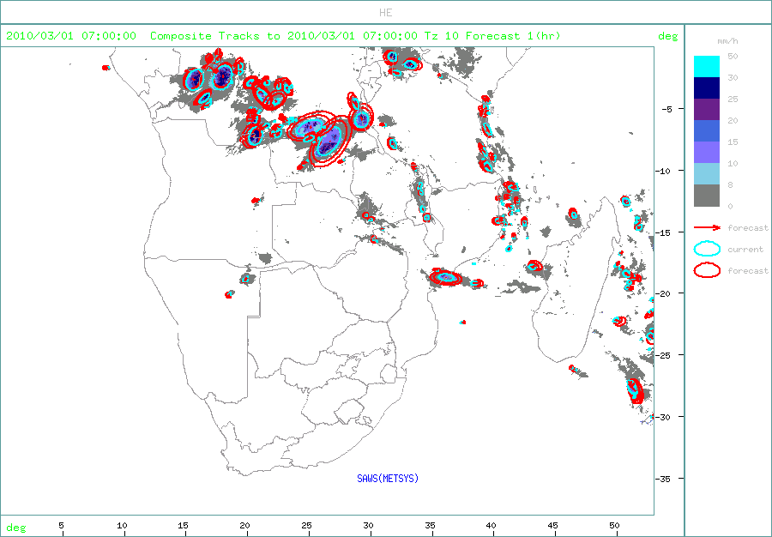
HE Tracking
HE tracking done of the 10mm (~40 dBz core)
Available on RSMC website: http://rsmc.weathersa.co.za/RSMC/login.php
Tracks storm direction for 30min and 60min forecasts.
Growth and decay accounted for

Slide 10
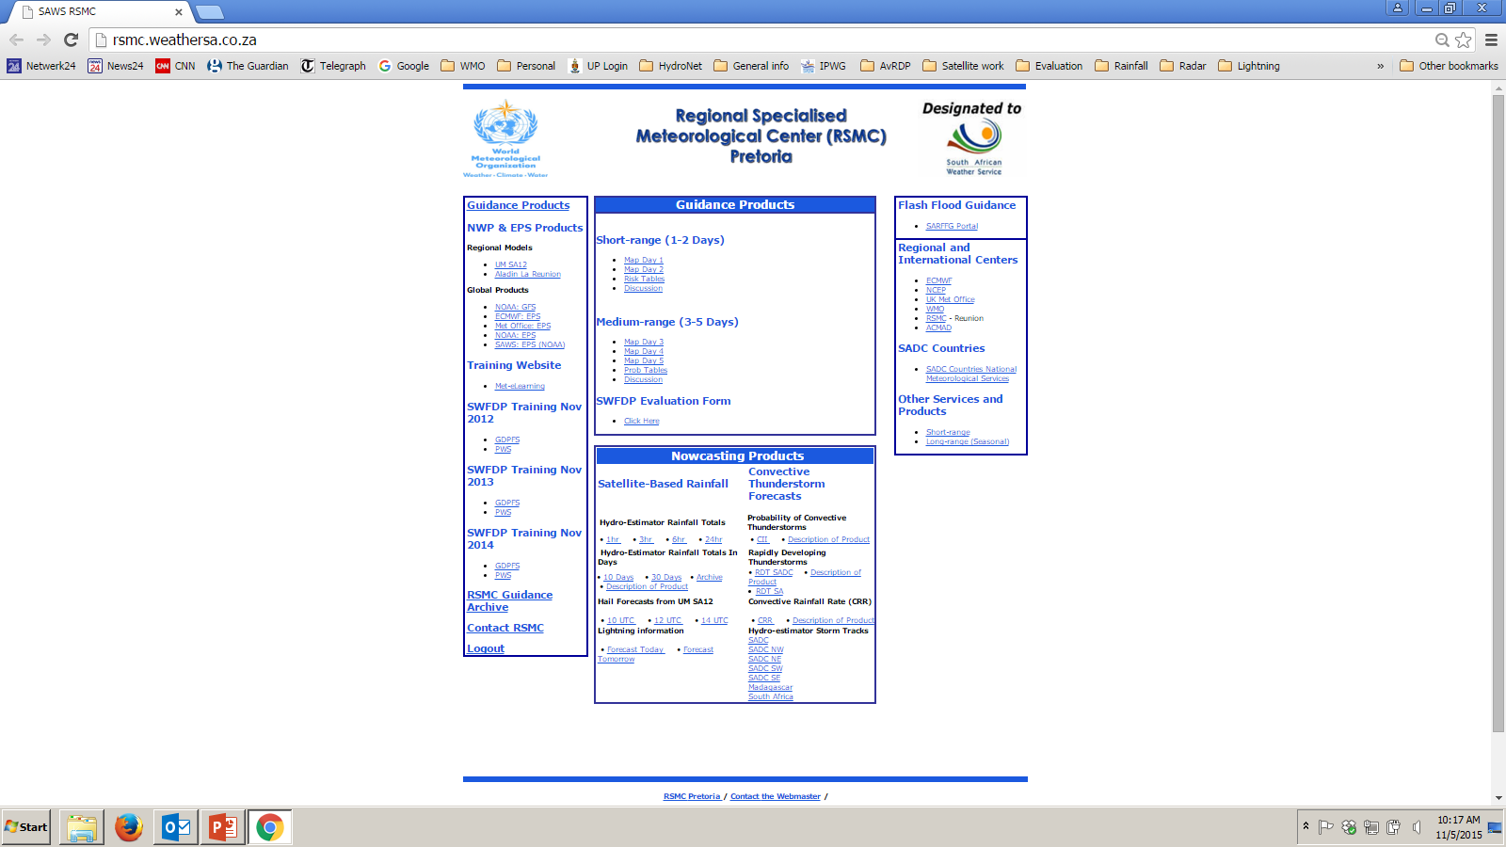

Slide 11
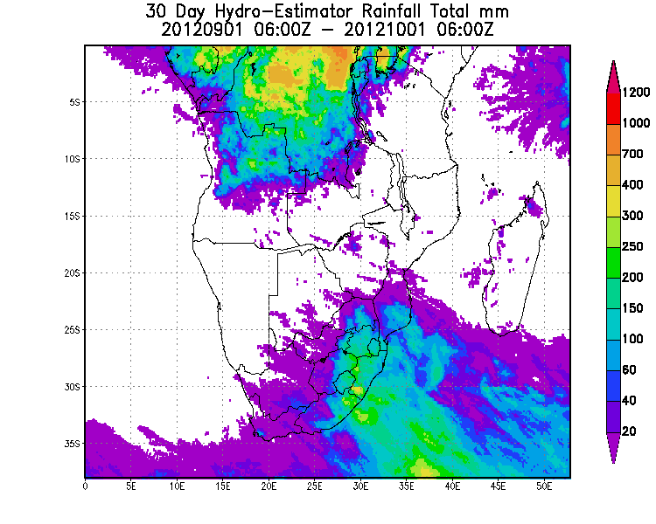
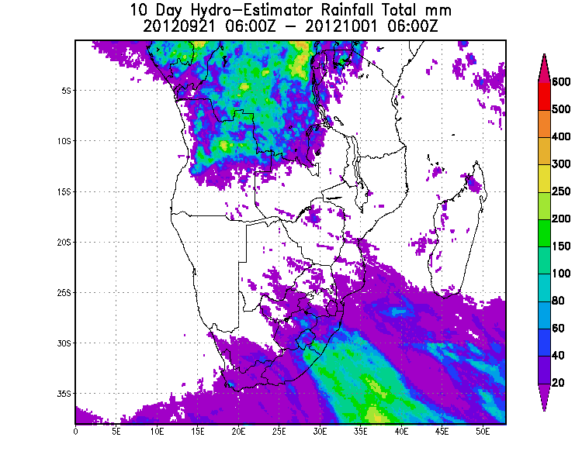
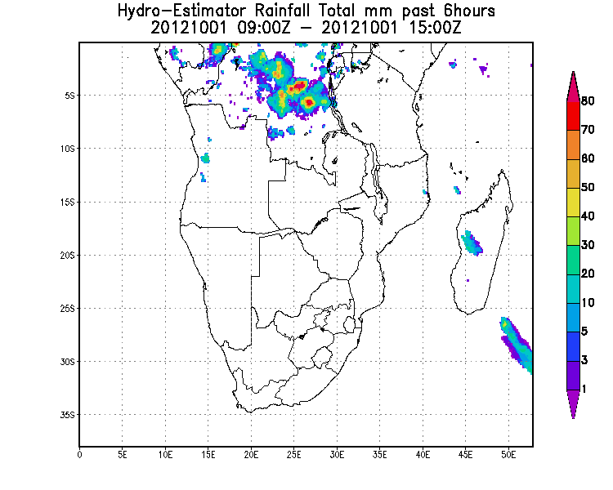
HE accumulations
1 hour, 3 hour, 6 hours, 24 hours
10 days
30 days
NEW! 32 day archive of daily totals

Slide 13
Uses for satellite QPE –SAFFG and SARFFG
WMO - flash flood guidance system over seven southern African countries
The SADC SARFFG system covers South Africa and six other countries where there are no radar coverage at the coarser 200km² resolution.
SARFFG depends primarily on satellite QPE as precipitation input for modelling soil moisture and flash flood guidance over large parts of southern Africa.
The Global Hydroestimator is used for this purpose

Slide 14
But wait… there is more…

Slide 15
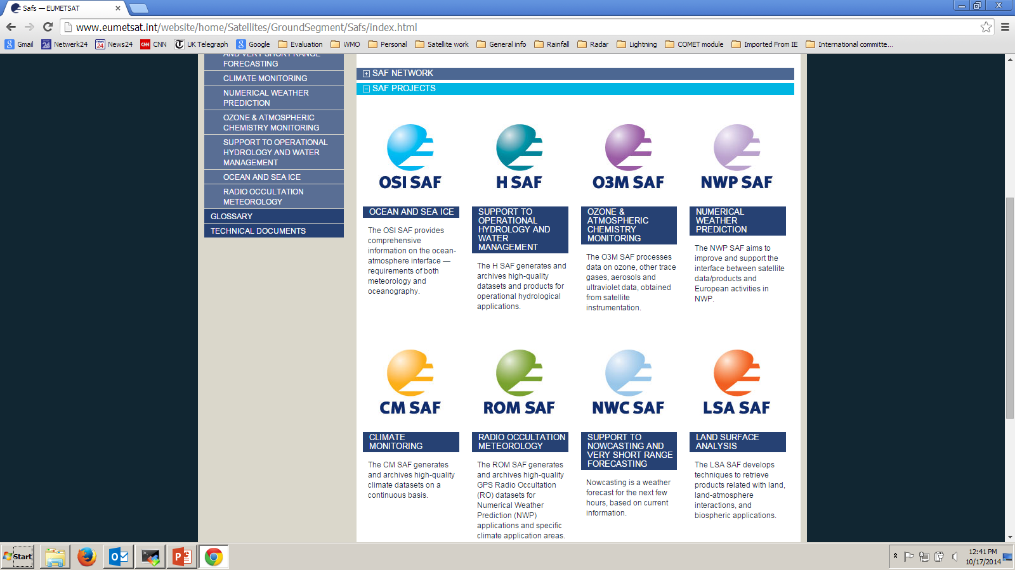
Satellite Application Facilities
The Nowcasting SAF started in February 1997 aiming to produce the software to deal with the Nowcasting and Very Short Range Forecasting using the characteristics of the MSG SEVIRI data and the NOAA and EPS AVHRR data (EUMETSAT Satellites).

Slide 16
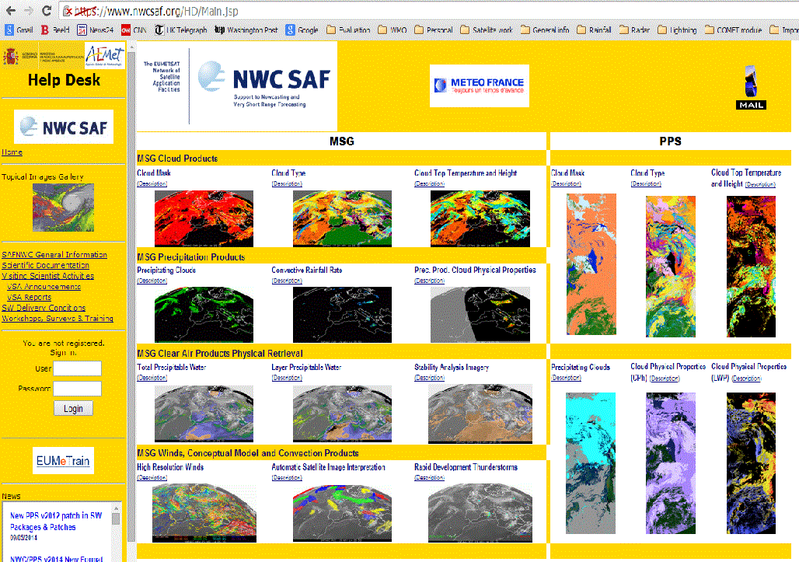
Nowcasting SAF products website
Cloud Mask
Cloud type
Cloud top temperature and height
Precipitation Clouds
Convective Rainfall Rate
Precipitation with microphysics
TPW
Layer PW
RDT
Stability indices
High Resolution wind
Satellite Image interpretation

Slide 17
CRR – theoretical background
Convective Rainfall Rate (CRR) product developed in the SAF NWC context, is a Nowcasting tool that provides information on convective, and stratiform associated to convection from MSG-SEVIRI channels.
CRR uses either 2 or 3 of the MSG SEVIRI channels:
  IR108 and (IR108 – WV062) (24hours)
  IR108, (IR108 – WV062) and VIS006 (day time only)
The empirical relationship than the higher and thicker are the clouds the higher is the probability of occurrence and the intensity of precipitation is used in the CRR algorithm.

Slide 18
CRR - a blended product
To take into account the influence of environmental and orographic effects on the precipitation distribution, some corrections can be applied to the basic CRR value, based on input from numerical weather prediction models:
  the moisture correction,
  the cloud top growth/decaying rates or evolution correction
  the cloud top temperature gradient correction
  the parallax correction
  the orographic correction
At the end of the process CRR product produces information on the instantaneous rain rate in mm/h in each pixel of the image.

Slide 19
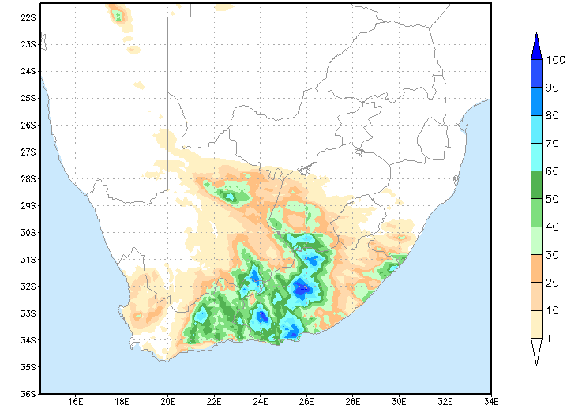
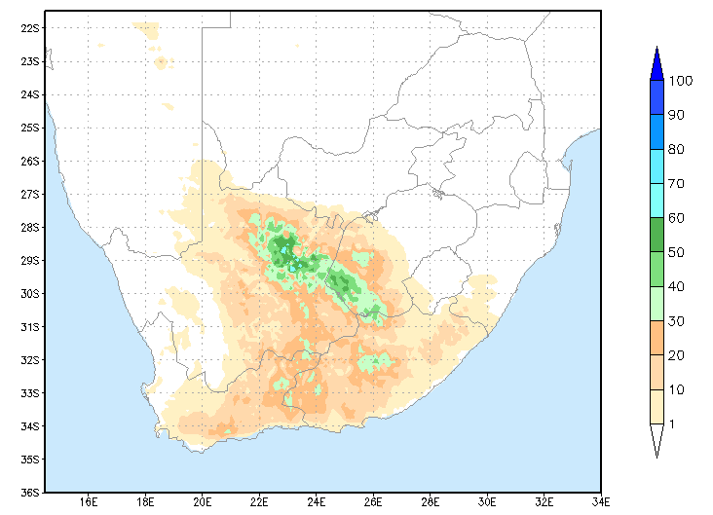
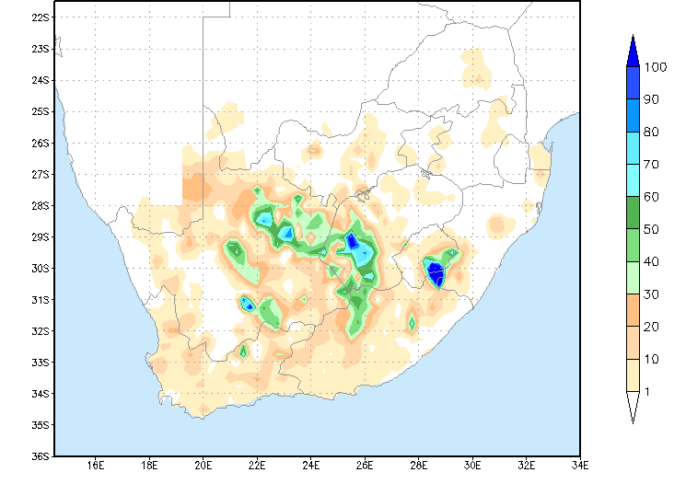
Example: Daily rainfall CRR vs Hydroe vs raingauges for 23 Feb 2010
Hydroestimator
Using 1 MSG channel
CRR using 3 MSG channels
Rain gauges

Slide 20
Hydroe vs CRR: RMSE and Correlation Coefficient
Hydroe – 1 MSG channel
CRR – 3 MSG channels
RMSE smaller
Correlation higher

Slide 21
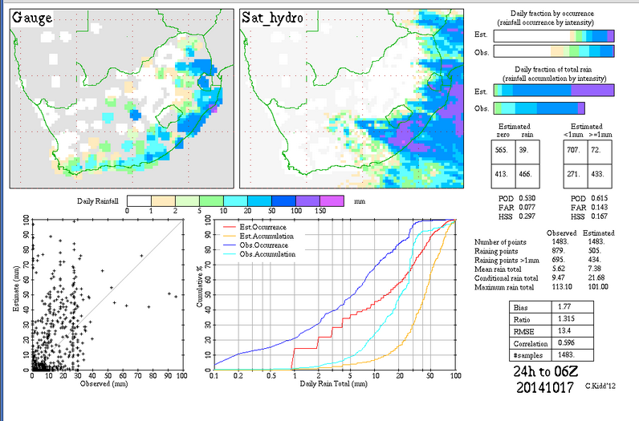
IPWG comparison – 16 Oct 2014
Hydroe:
POD 0.615
FAR 0.143
HSS 0.167
RMSE 13.4
Correlation 0.596

Slide 22
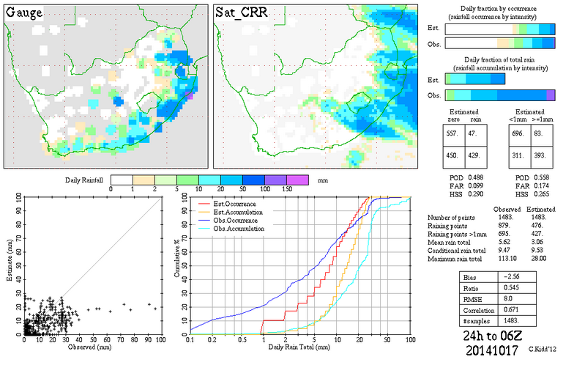
IPWG comparison – 16 Oct 2014
CRR:
POD 0.558
FAR 0.174
HSS 0.265
RMSE 8.0
Correlation 0.671

Slide 23
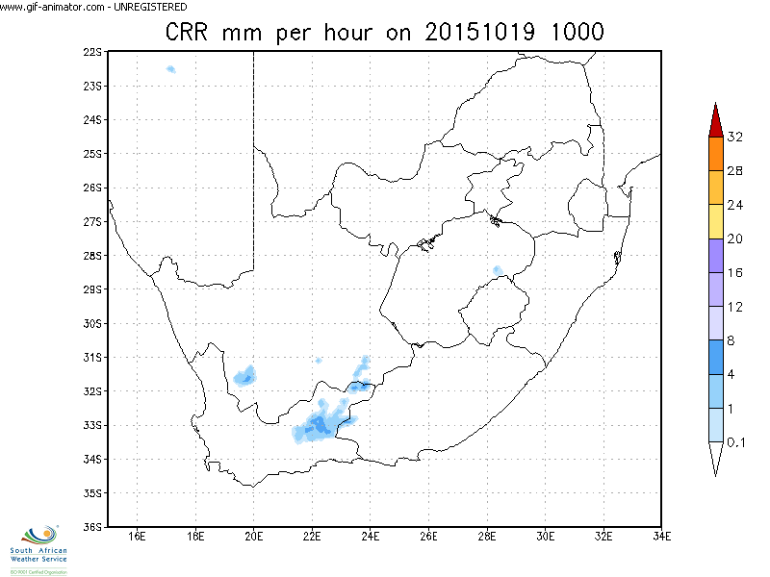
CRR 19 October 1000-1200 UTC

Slide 25
Summary
GEO satellite QPE can provide good estimates of rainfall intensity in real time
In data sparse regions: Satellite QPE are especially useful where we don’t have rain gauges (or radar rainfall)
CRR is now operational for SADC region and seems to be outperforming Hydroe
Future work – Continuous testing/perhaps replacing Hydroe with CRR in some places/products

